Slide 1

JEDI BOOTCAMP
Presented by : Group 5
Guided By : Amit Balyan

Slide 2
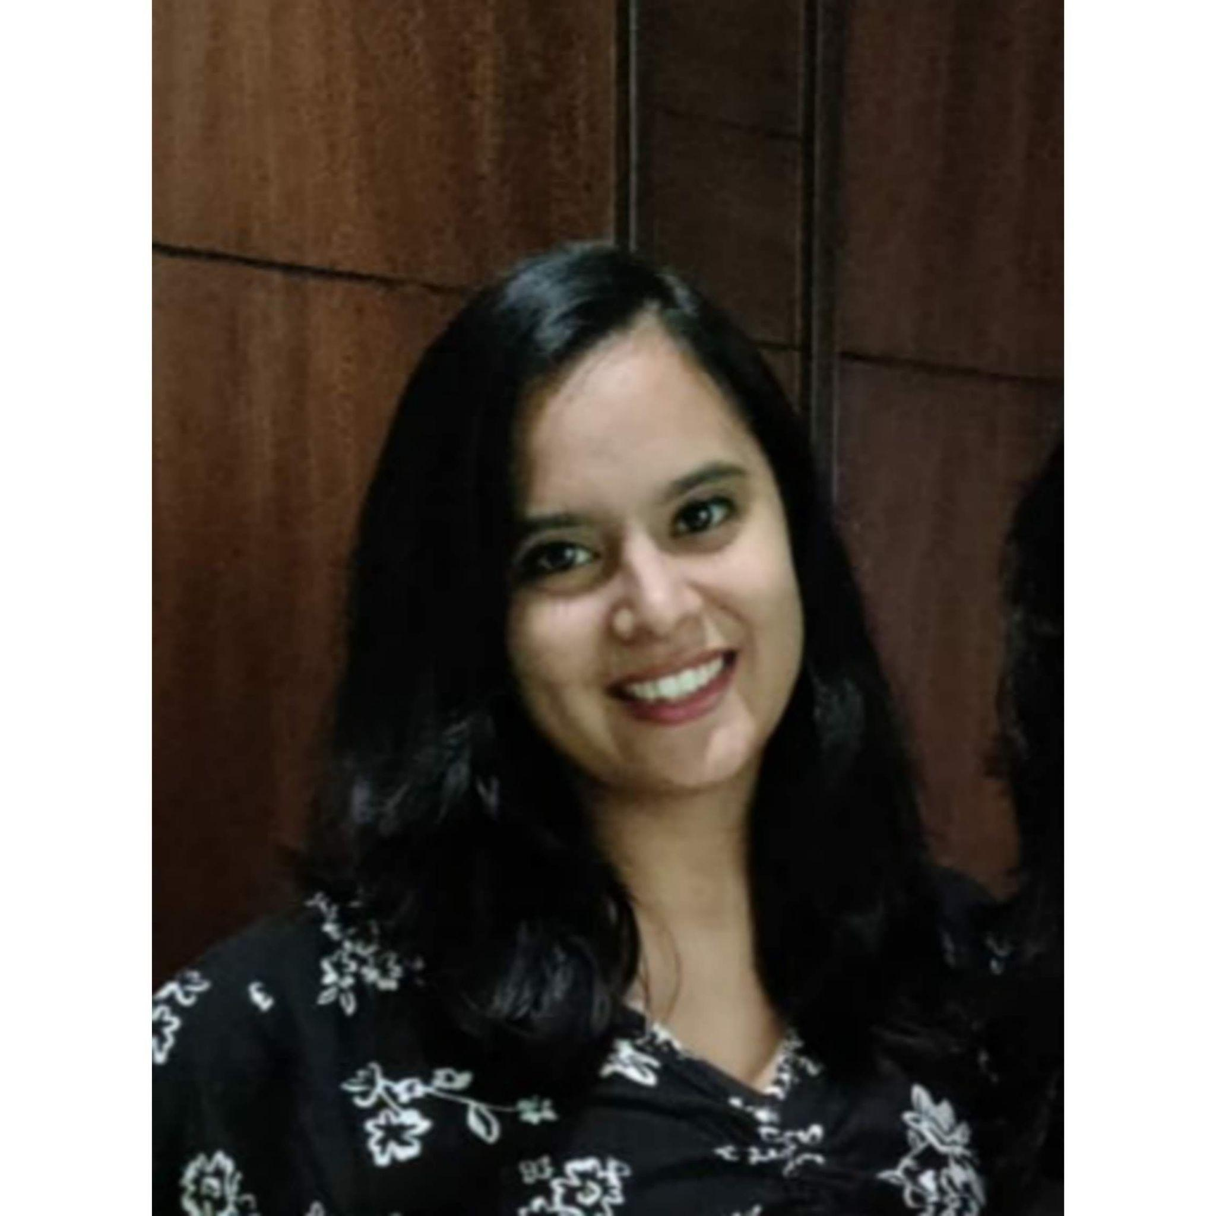
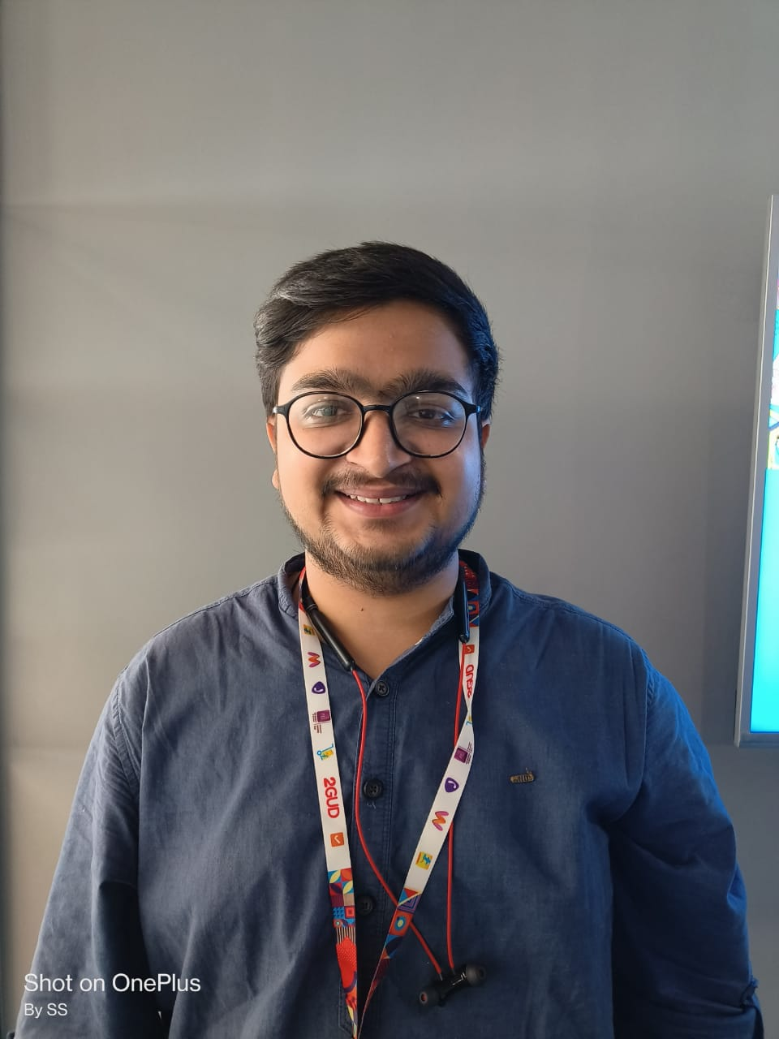
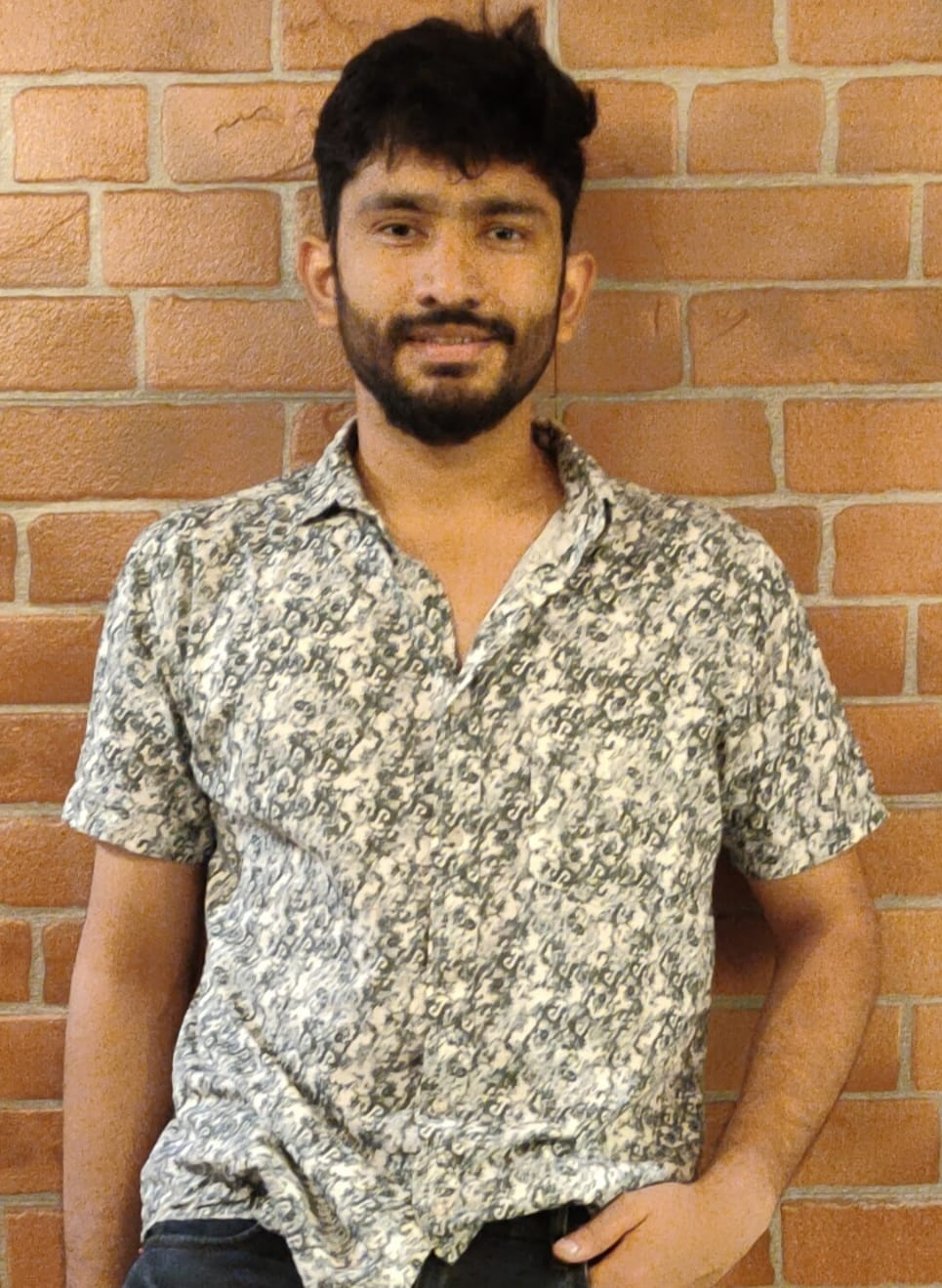

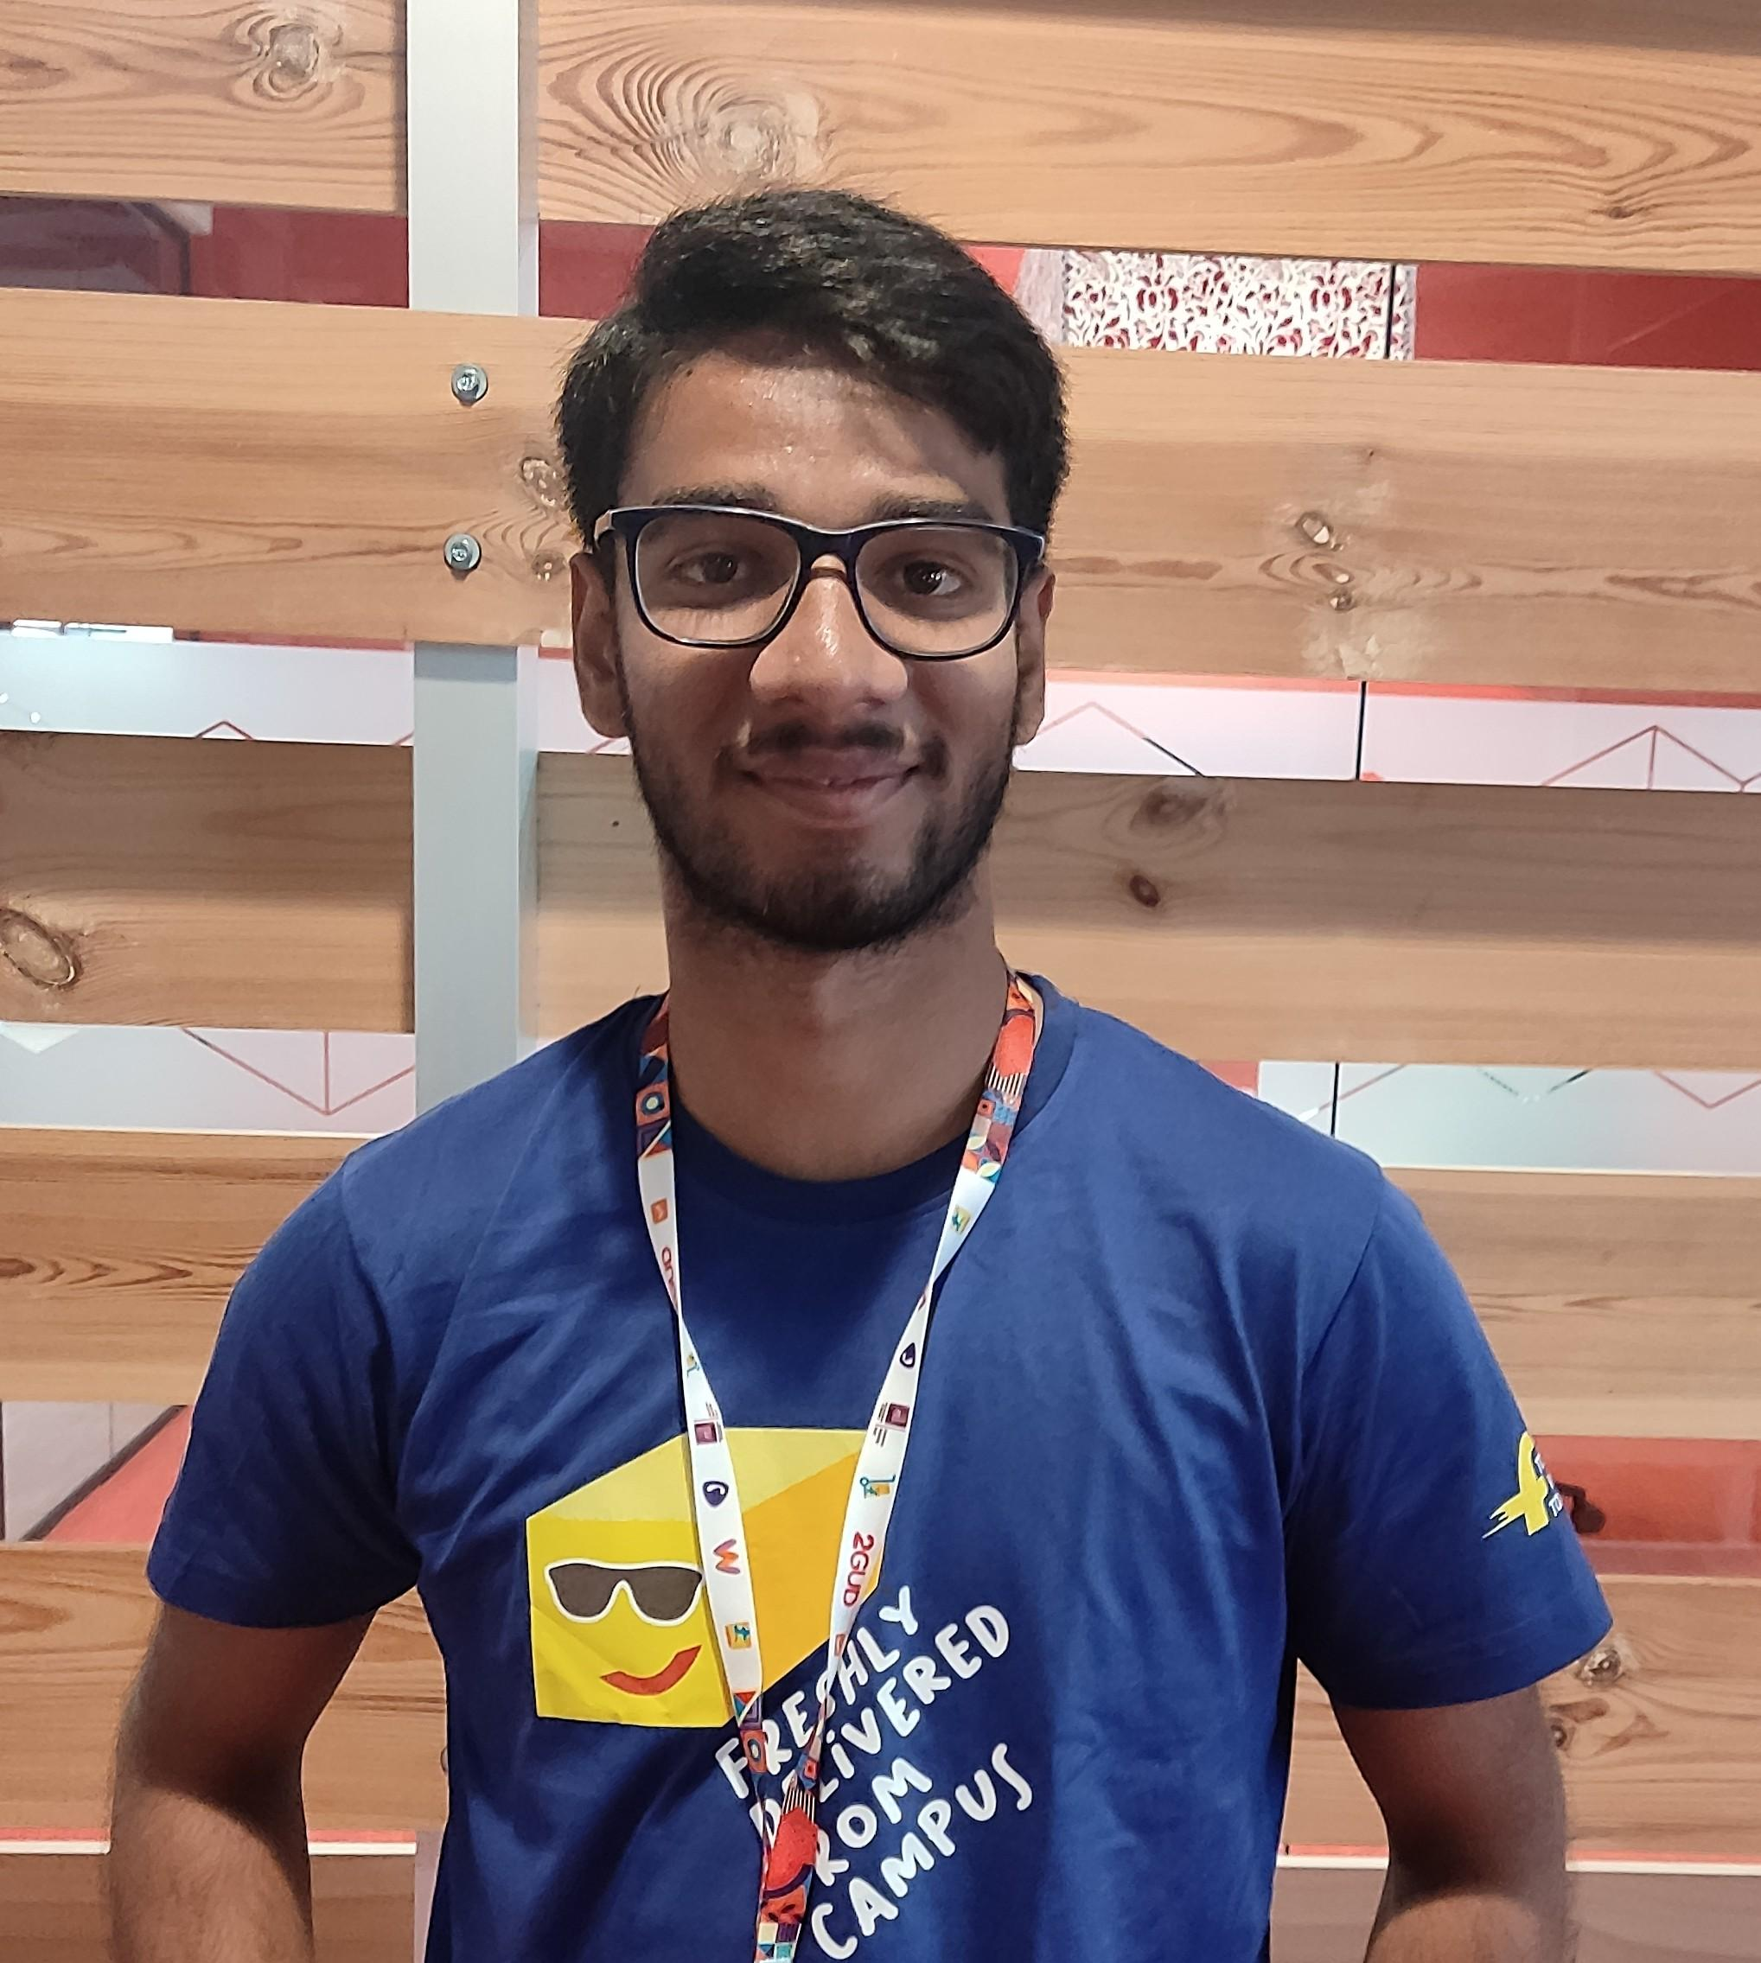
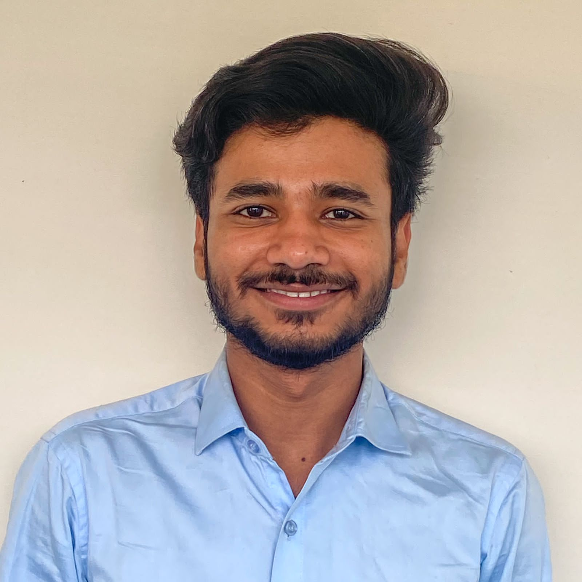
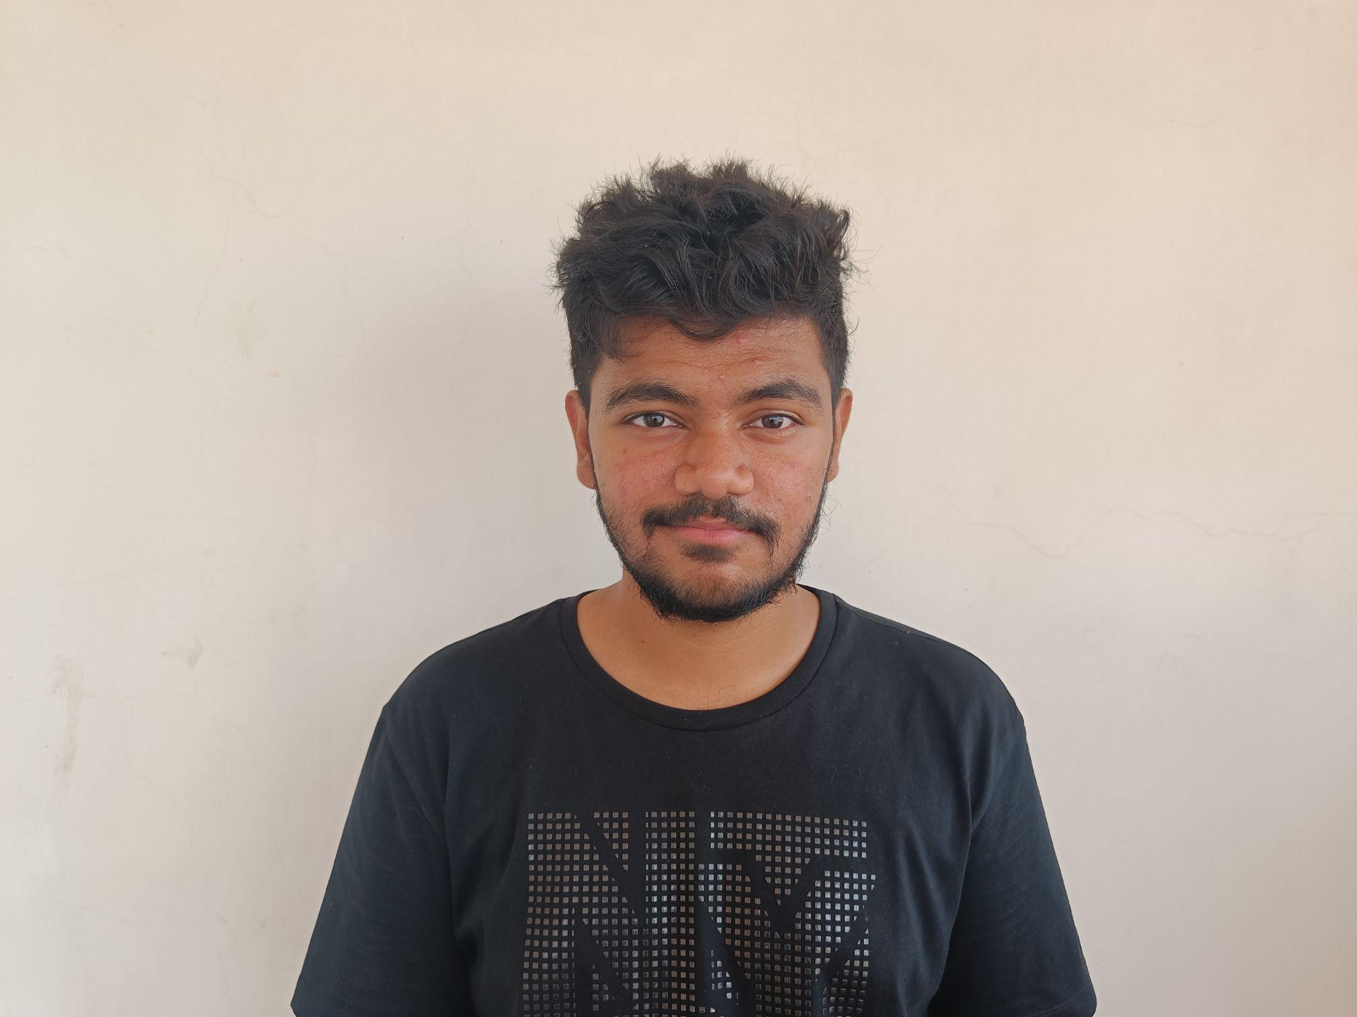
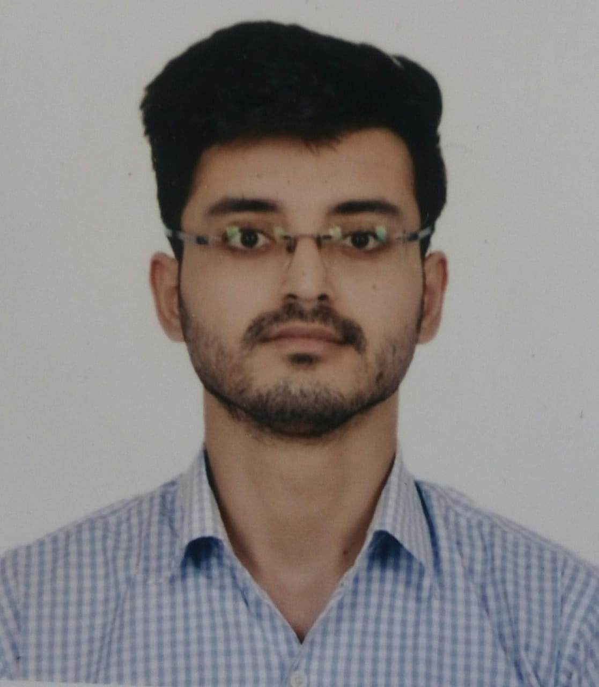
OUR TEAM
Shruti Simran
Parth Khanna
Ashwani Yadav
Shefali Verma
Rohit Reddy
Prakhar Mewara
Vedala Sai Ashok
Mohd Arbab

Slide 3
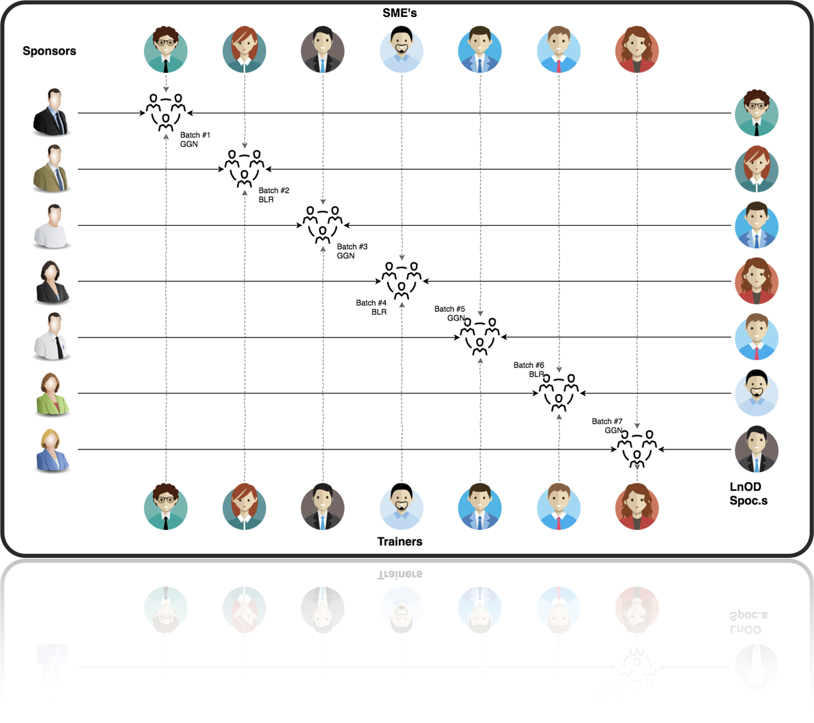
STAKEHOLDERS
Sponsors : Flipkart
SME: Shree Laxmi
Trainer : Amit Balyan

Slide 4

FRAMEWORK
REST API
DropWizard
&
Project Migration
5
6
Java Basics
&
Backend Code
3
4
Linux commands
Git commands
SDLC
MySQL
&
JDBC
1
2
UML Modelling

Slide 5
AGENDA
1
2
3
4
5
6
TECH STACK
DEVELOP-
MENT
DEMO
QUESTIONS
PROBLEM STATEMENT
CHALLEN-
GES

Slide 6
PROBLEM STATEMENT
The aim of the project is to develop a Course Registration System for universities
The system should have three different types of users, i.e., students, professors and admins and should offer different features relevant to these users
The features offered should be as follows:
STUDENT
PROFESSOR
ADMIN
Register
Apply for courses from course catalog
Add/drop courses
See grades
Make fee payment
Manage Users
Manage course catalog
Approve students for course registration.
Approve courses registered for by students.
Choose courses to teach
Grade students enrolled in their courses

Slide 7








TECH STACK
Bash shell
Java
Dropwizard
04
06
01
03
02
05
07
08
IntelliJ
Git

Slide 8

DEVELOPMENT

Slide 9
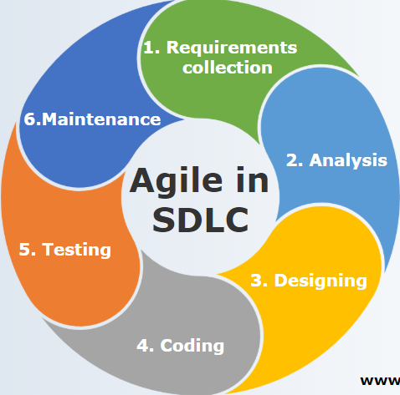
DEVELOPMENT CYCLE

Slide 10



SYSTEM ARCHITECTURE
Send HTTP request
Postman
Receive HTTP response
Database
Java REST Application
Service Class
Database Class

Slide 11


Slide 12
Learnings
01
Familiarization with bash and git commands
Understanding software development life cycles
02
03
Creating various UML diagrams
Learning Java and new features in Java 8/11
04
05
Connecting database to project
Generating Javadoc & application monitoring
06
07
Integrating REST services with Java code
Integrating Dropwizard
08
09
Using Postman to test REST APIs
Collaborating code in a team
10

Slide 13
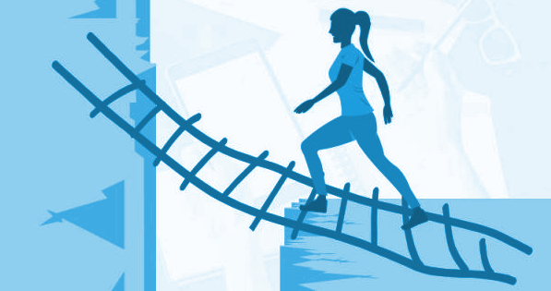
CHALLENGES
Git merge conflicts
Understanding client requirements
Resolving errors due to dependency on different versions among libraries
Database integration
Debugging took lot of time

Slide 14

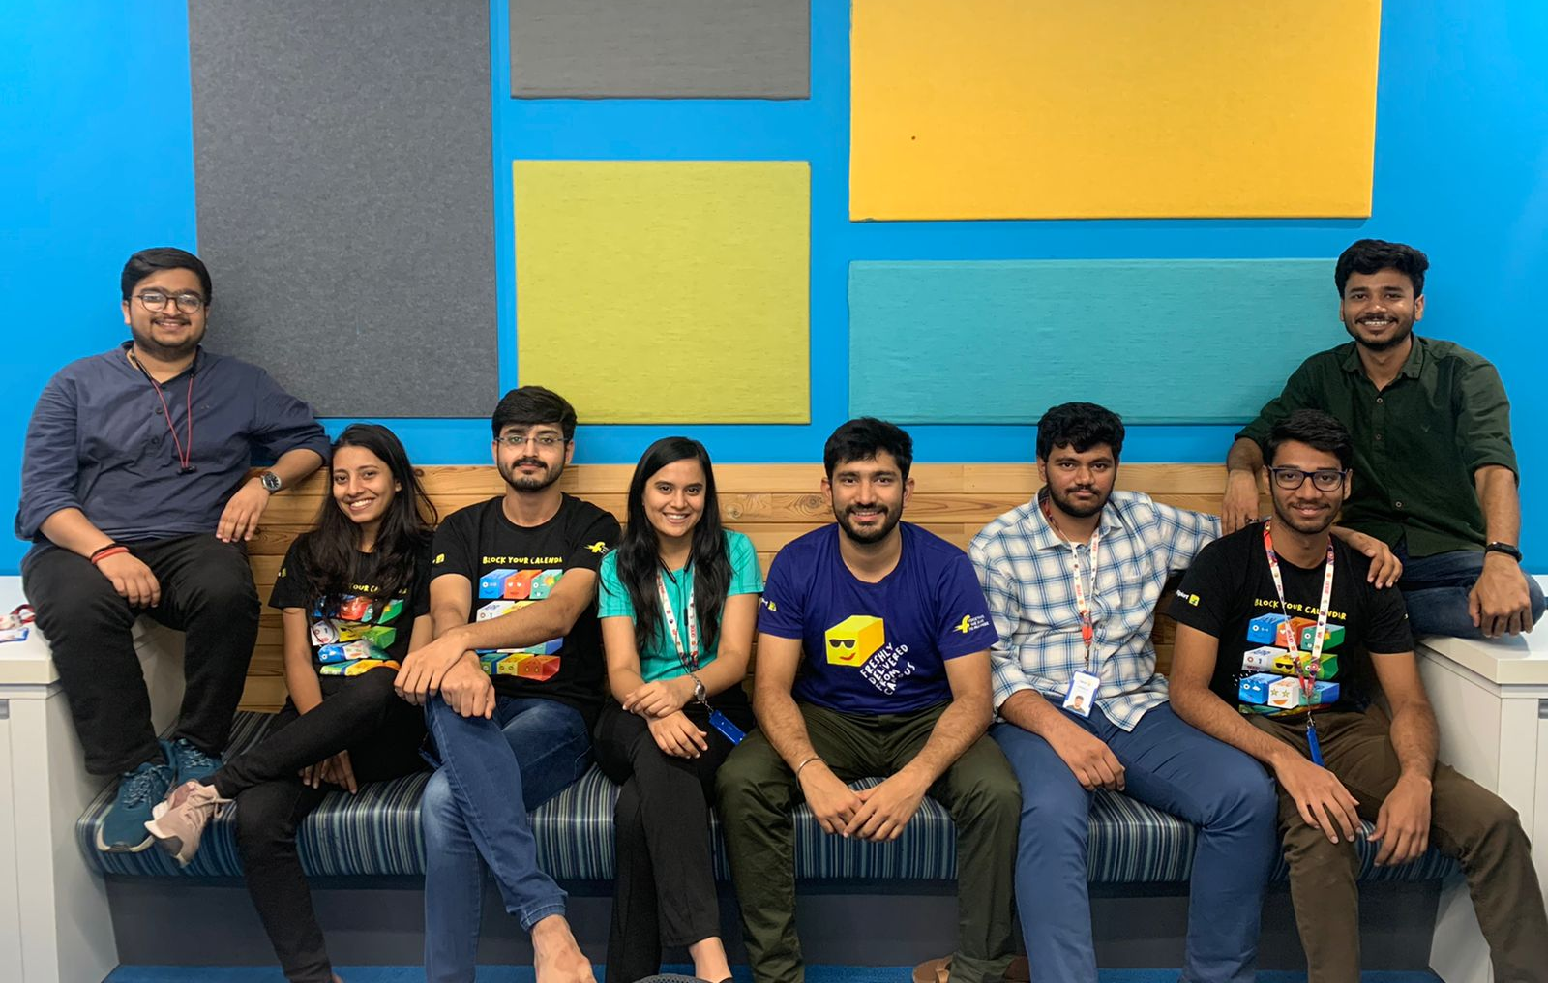
git commit -m “Thank You”
G
R
O
U
P
5
THANK
YOU!!

